Slide 1
Reinforcement Learning
Capstone Project – Using DDPG

Slide 2
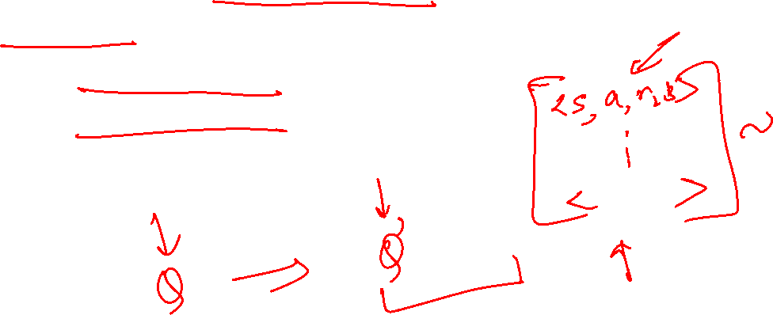
Why Deep Deterministic Policy Gradients?
Can work well in continuous action domains.
Actor-critic based, model free approach.
Uses Experience Replay.
Uses Target Networks.

Slide 3



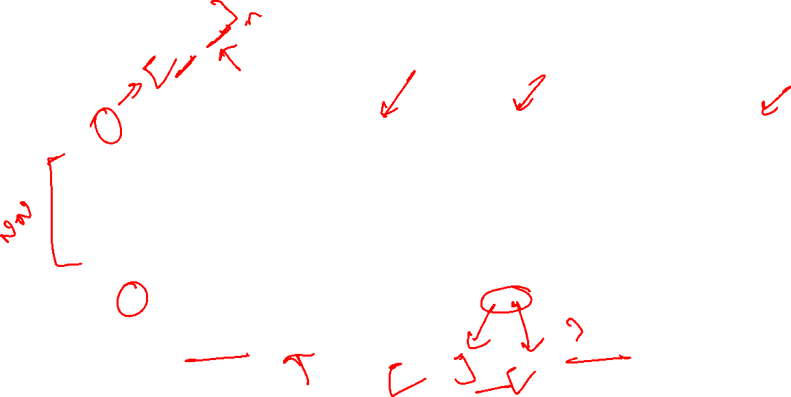





Model Architecture
$$a=π(s)$$
$$a=π′(s)$$
$$Q(s,a)$$
$$Q′(s,a)$$
$$s$$
$$s$$
$$s,a$$
$$s,a$$
Target Network
Target Network
Actor
Critic

Slide 4
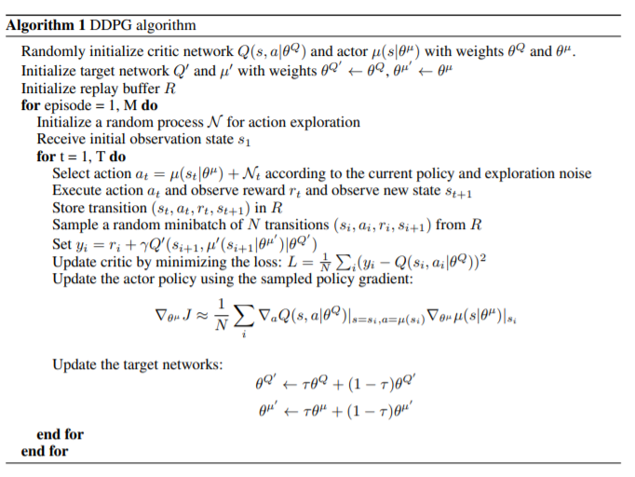
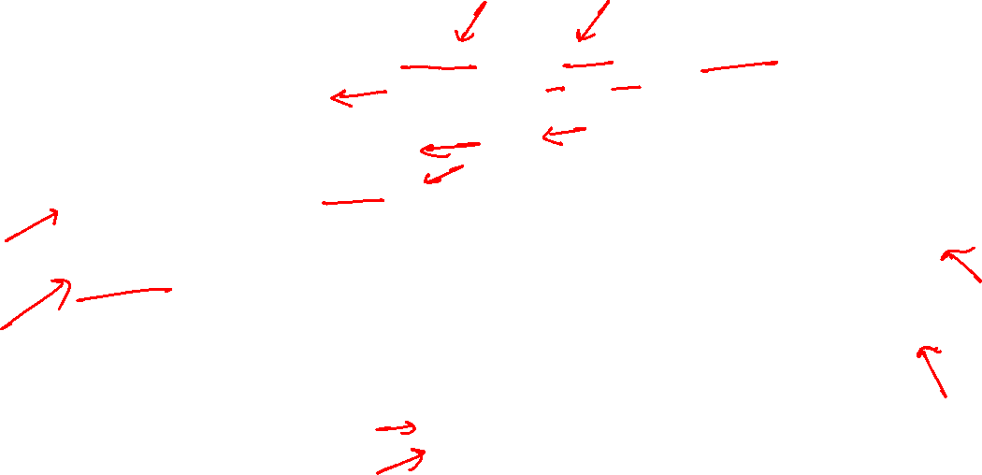
DDPG Algorithm
Action selection and execution
Storing and sampling transitions
Updating Critic
Updating Actor
Updating target actor & target critic

Slide 5
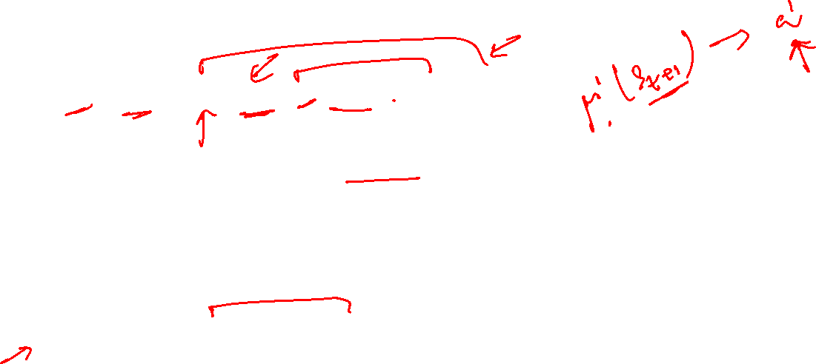
Updating Critic
Action for next state, as per actor target model
Q value for next state and next action (suggested by actor target model), as per critic target model.
Q value for current state and current action, as per critic model

Slide 6
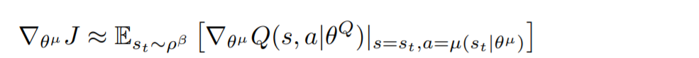
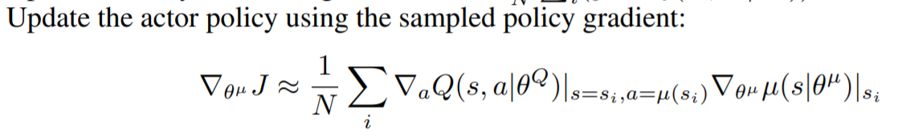
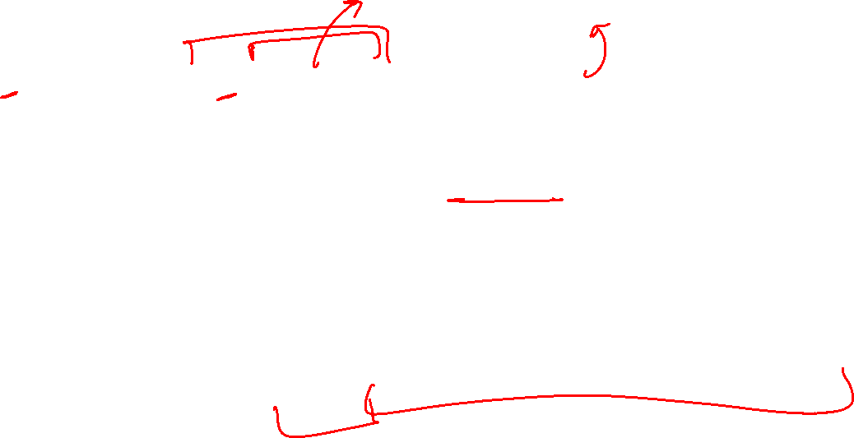
Updating Actor
Gradient of cost w.r.t actor parameters
Gradient of critic network w.r.t actor parameters
Action suggested by actor network

